Slide 1

Columbia Asia Hospital Project
Power BI Project
by Saurabh Sharma

Slide 2
AGENDA
PROBLEM STATEMENT
DATA DESCRIPTION
ANALYSIS OBJECTIVES
MAIN DASHBOARD
DOCTORS DASHBOARD
PATIENTS DASHBOARD
CONCLUSION

Slide 3
PROBLEM STATEMENT
You have been hired as a consultant data analyst by Columbia Asia Hospital. The Hospital is looking for key insights for the following objectives:
Assess the hospital's revenue generation
Insights about suitable departments for new hires
Strategies suggestions for patient discounts.
Your task is to perform data analysis and come up with a report in order to help the organisation with the mentioned objectives.

Slide 4
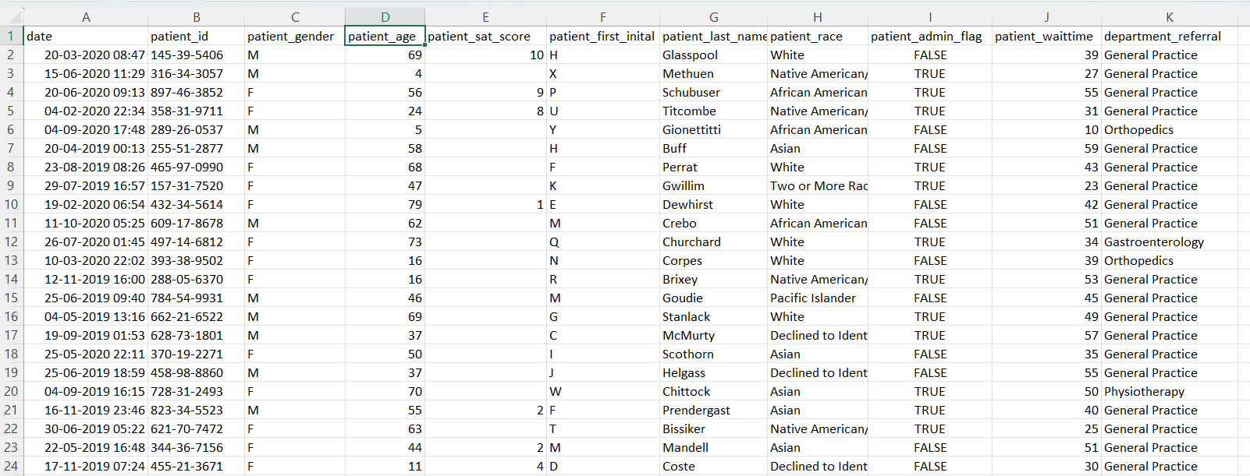
PROBLEM STATEMENT

Slide 5
DATA DESCRIPTION
Date – Patient visit date and time • Patient ID – Unique identifier for each patient • Patient Gender – Male or Female • Patient Age – Age of the patient • Patient Patient Race – Demographic category of patient • Patient Wait Time – Time patient waited before treatment • Department Referral – Department assigned to patient • Doctor Name – Doctor who treated the patient • Total Bill – Total revenue generated from patientSatisfaction Score – Rating given based on experience

Slide 6
Analysis Objectives
Monthly Patient Visits Analysis
Wait Time vs Satisfaction
Department-wise Patient Load
Demographics Impact
Discount Strategy
Hiring Recommendation
Profitability Analysis
Doctor Shift Strategy

Slide 7
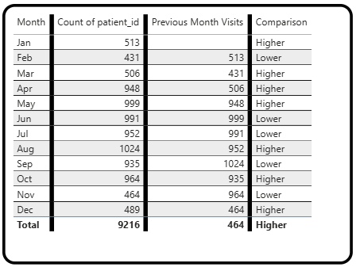
Monthly Patient Visits Analysis
Patient visits fluctuate significantly across months • Peak visits observed in August (1024 patients) • Lowest visits recorded in February (431 patients) • Several months show decline compared to previous month • Overall trend indicates seasonal variation in hospital visits

Slide 8
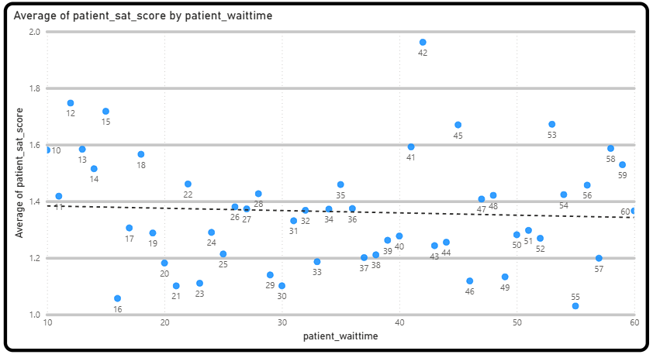
Wait Time vs Satisfaction
Patient satisfaction varies with waiting time • Higher waiting time generally leads to lower satisfaction • Some outliers exist but overall negative trend is visible • Patients with shorter wait time show better satisfaction scores • Reducing waiting time can significantly improve patient experience

Slide 9
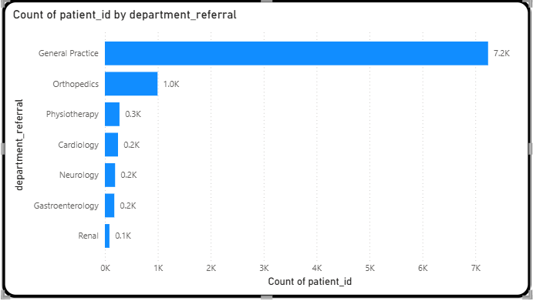
Department-wise Patient Load
• General Practice handles the highest number of patients (~7.2K) • Orthopedics is the second most visited department (~1K) • Other departments have significantly lower patient counts • Patient distribution is highly concentrated in one department • Indicates need for better resource allocation across departments

Slide 10
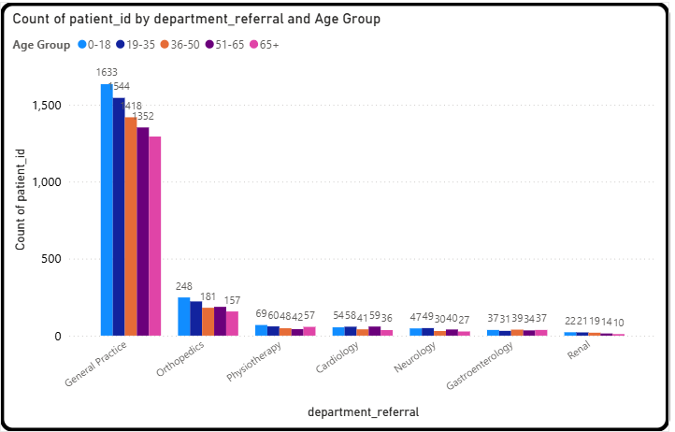
Demographics Impact
• General Practice is the most visited department across all age groups • Younger age groups (0–18, 19–35) have higher hospital visits • Patient visits gradually decrease with increasing age • Specialized departments have relatively lower visits across all age groups • Indicates higher dependency on general healthcare services among all demographics

Slide 11
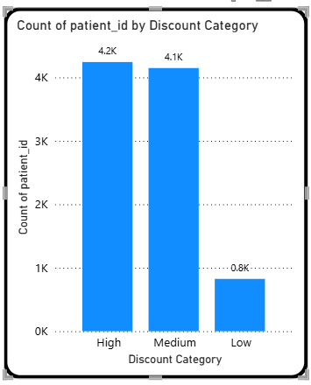
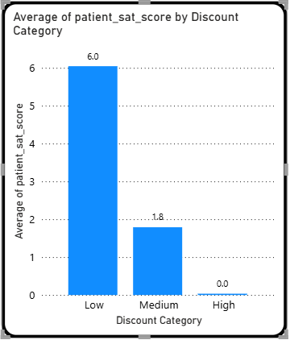
Discount Strategy
High and Medium discount categories have the highest patient count • Low discount category has significantly fewer patients • Patient satisfaction is highest in the Low discount category • High discount category shows the lowest satisfaction levels • Indicates that higher discounts are linked with lower satisfaction and higher issues (like long wait time)

Slide 12
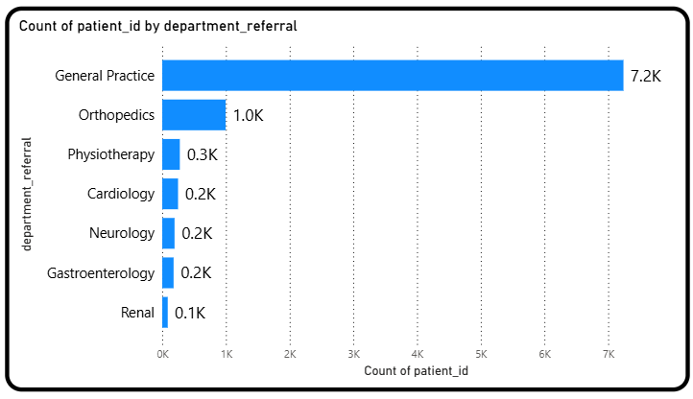
Hiring Recommendation
General Practice has the highest patient load among all departments • Orthopedics is the second most demanded department • Other departments have significantly lower patient visits • High workload indicates need for additional doctors in key departments • Hiring in General Practice and Orthopedics can improve efficiency and reduce wait time

Slide 13
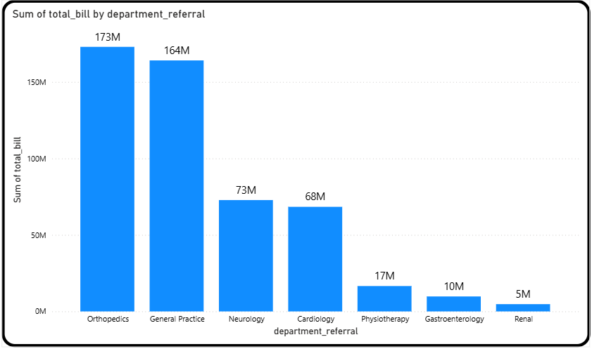
Profitability Analysis
Orthopedics generates the highest revenue among all departments • General Practice is the second highest revenue contributor • Neurology and Cardiology contribute moderate revenue • Other departments generate relatively low revenue • Hospital shows strong revenue concentration in top departments

Slide 14
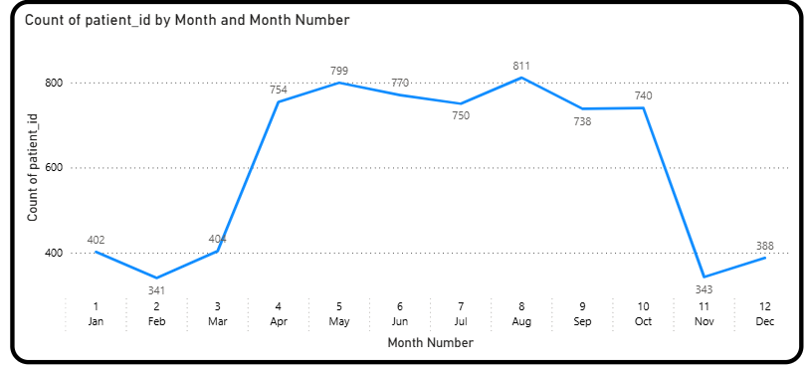
Doctor Shift Strategy
Patient visits fluctuate significantly across months • Peak visits observed in August and May • Lowest visits recorded in February and November • Sudden drops and spikes indicate irregular demand patterns • Suggests need for better planning during peak and low periods

Slide 15
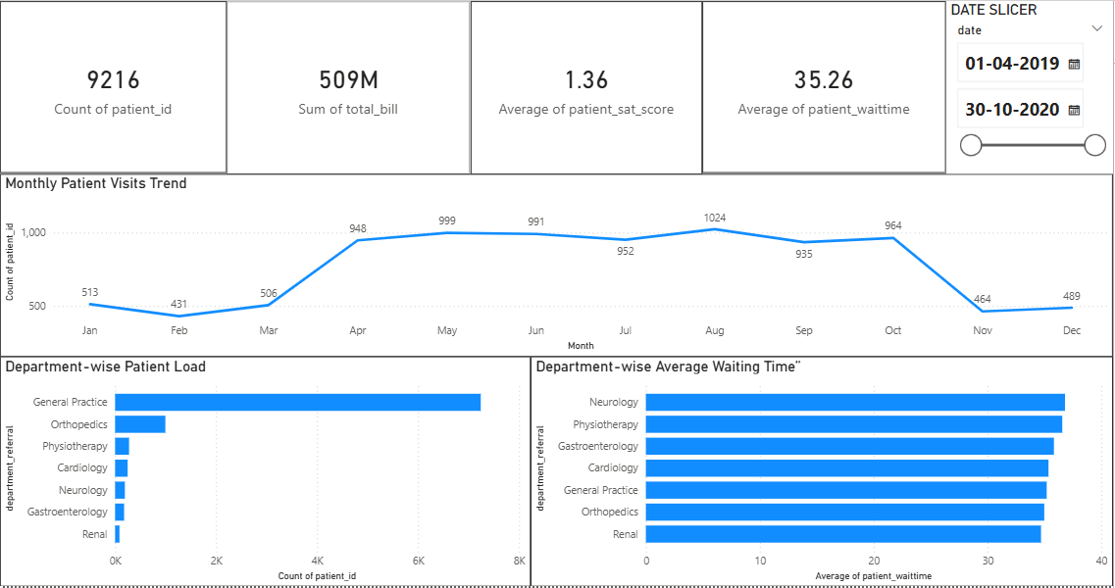
Main Dashboard

Slide 16
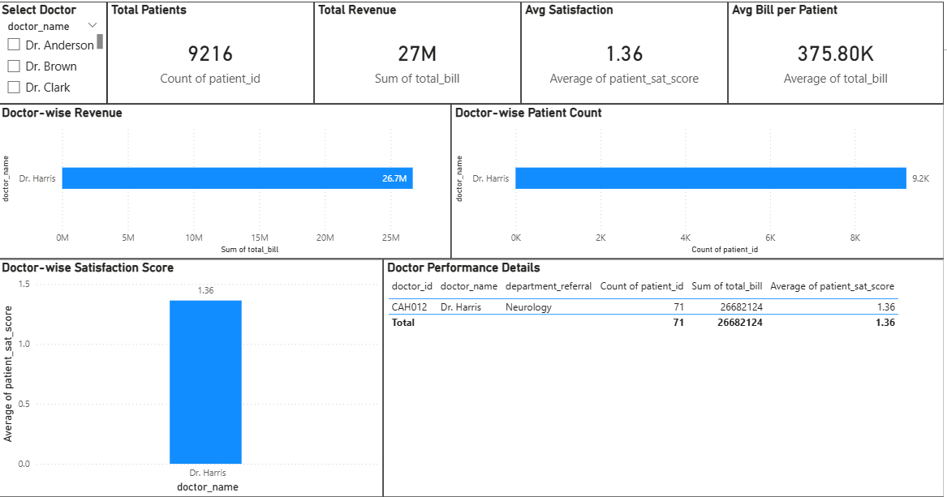
Doctors Dashboard

Slide 17
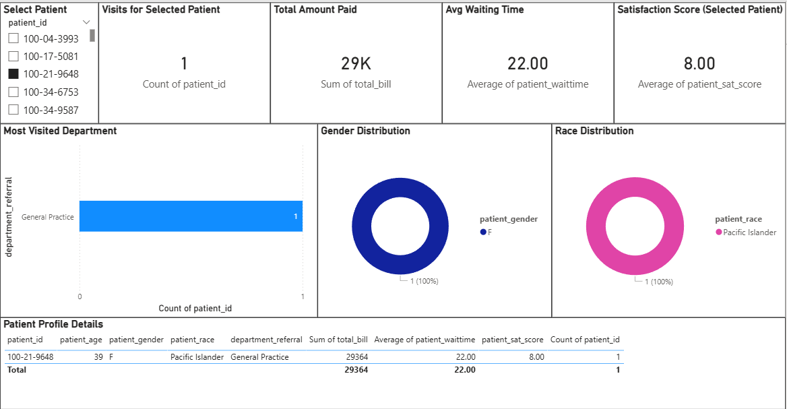
Patients Dashboard

Slide 18
Conclusion:
• Patient visits show clear monthly fluctuations, indicating seasonal demand patterns • General Practice and Orthopedics handle the majority of patient load and revenue • Higher waiting time negatively impacts patient satisfaction • Demographic factors influence department preferences and hospital usage • Implementing strategies like hiring, shift planning, and targeted discounts can improve efficiency and patient experience

Slide 19
THANK YOU

